Slide 1
Chapter 13
Progress and Performance
Measurement and Evaluation

Slide 2
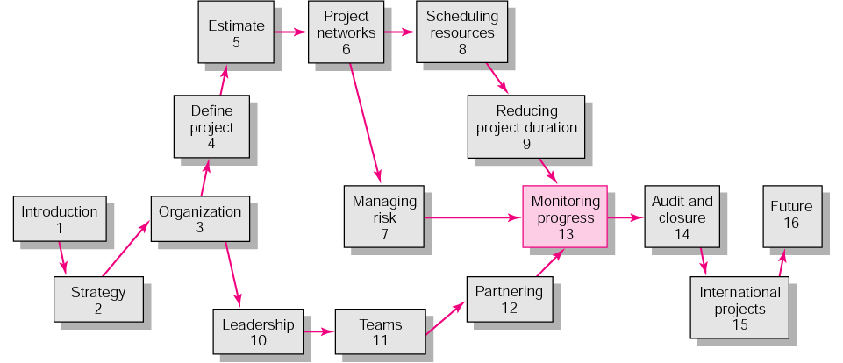
Copyright © 2006 The McGraw-Hill Companies. All rights reserved.
McGraw-Hill/Irwin 13–<number>

Slide 3
Control by “wandering around” and/or “involvement” can overcome most problems in small projects
However…
  Large projects need some form of formal control
Copyright © 2006 The McGraw-Hill Companies. All rights reserved.
McGraw-Hill/Irwin 13–<number>
Notes:
Evaluation and control are parts of every project manager’s job.
Control holds people accountable, keep them staying focus. Control also help people identify and deal with problems before they can become large ones.
For effective control, the project manager needs a single information system to collect data and report project progress in terms of cost, schedule, and performance/ specification.
So, in this chapter, we are discussing…
“prevents small problems from mushrooming into large problems”

Slide 4
Content
Structure of a Project Monitoring Information System
The Project Control Process
Monitoring Time Performance
Development of an Earned Value Cost/Schedule System
Developing a Status Report: A Hypothetical Example
Indexes to Monitor Progress
Forecasting Final Project Cost
Other Control Issues
Key terms
Copyright © 2006 The McGraw-Hill Companies. All rights reserved.
McGraw-Hill/Irwin 13–<number>

Slide 5
Project Monitoring System for Control
Information System Structure
  What data are collected?
    Current status of project (schedule and cost)
    Remaining cost to compete project
    Date that project will be complete
    Potential problems to be addressed now
    Out-of-control activities requiring intervention
    Cost and/or schedule overruns and the reasons for them
    Forecast of overruns at time of project completion
Copyright © 2006 The McGraw-Hill Companies. All rights reserved.
McGraw-Hill/Irwin 13–<number>
Notes:
The project monitoring system involves determining what data to be collected; how, when, and who will collect the data; analysis of the data; and reporting the current progress.
First, in determining what data should be collect for the project control, some typical key data are actual activity duration times, resource usage, actual cost. They are then compared against planned time, resource, and cost.
In this step, we collect data that support to answer following questions:…

Slide 6
Project Monitoring System… (cont’d)
Information System Structure (cont’d)
  Collecting data and analysis
    Who will collect project data?
    How will data be collected?
    When will the data be collected?
    Who will compile and analyze the data?
  Reports and reporting
    Who will receive the reports?
    How will the reports be transmitted?
    When will the reports be distributed?
Copyright © 2006 The McGraw-Hill Companies. All rights reserved.
McGraw-Hill/Irwin 13–<number>
Notes:
Second, we identify how, when, and who will collect the data.
Who will collect the data? Team member? Sub-contractor? Engineer? Or Project manager?
How? → checklist? Or through some electronic machines?
When will we collect the data? Every one hour, or 4 hours? Everyday? Or every week?
And then, after analyzing the data, the right report should be sent to right person. Different stakeholders have different interests related to our project. Ex: top managers usually want to know if the project is on time and within budget. And if not, what corrective actions should be taken place.
Project team members focus on their deliverables and specific work package. We should design our report suitable for right audience.

Slide 7
Project Progress Report Format
Progress since last report
Current status of project
  Schedule
  Cost
  Scope
Cumulative trends
Problems and issues since last report
  Actions and resolution of earlier problems
  New variances and problems identified
Corrective action planned
Copyright © 2006 The McGraw-Hill Companies. All rights reserved.
McGraw-Hill/Irwin 13–<number>
Notes:
As usual, project progress reports are designed and communicated in written and oral form. The typical format of the report is as follow:…

Slide 8
The Project Control Process
Control
  The process of comparing actual performance against plan to identify deviations, evaluate courses of action, and take appropriate corrective action.
Project Control Steps
  Setting a baseline plan.
  Measuring progress and performance.
  Comparing plan against actual.
  Taking actions
Copyright © 2006 The McGraw-Hill Companies. All rights reserved.
McGraw-Hill/Irwin 13–<number>
Notes:
2 → use qualitative or quantitative approach. In this chapter, we only discuss quantitative method, for specific, that’s earned-value method.
3 → to evaluate the deviation from plan to determine if action is necessary. Usually, the status report should be taken place once every one to four weeks
4 → if the deviation is significant (the gap between actual and plan is large enough)

Slide 9
Monitoring Time Performance
Tools used to catch negative variances from plan and communicate project schedule status:
  Tracking and baseline Gantt charts
    Show expected, actual, and trend data for event duration performance.
  Control charts
    Plot the difference in scheduled time on the critical path with the actual point on the critical path.
Copyright © 2006 The McGraw-Hill Companies. All rights reserved.
McGraw-Hill/Irwin 13–<number>

Slide 10
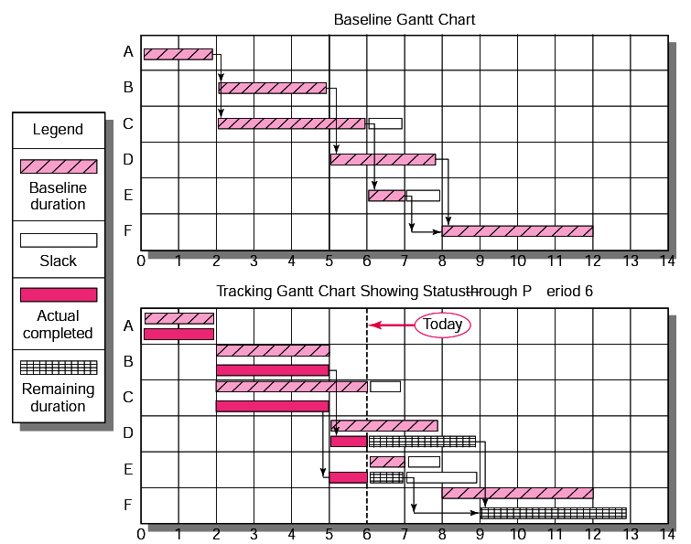
Baseline and Tracking Gantt Charts
FIGURE 13.1
Copyright © 2006 The McGraw-Hill Companies. All rights reserved.
McGraw-Hill/Irwin 13–<number>
Notes:
TRACKING CHART

Slide 11
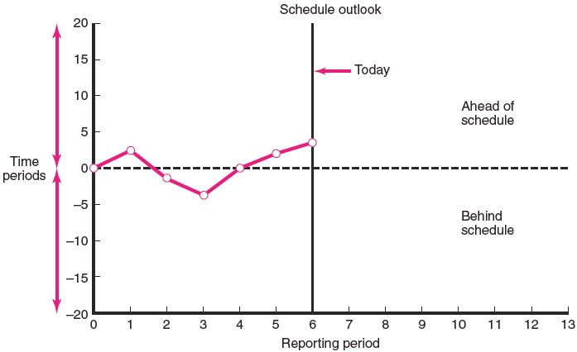
Project Schedule Control Chart
FIGURE 13.2
Copyright © 2006 The McGraw-Hill Companies. All rights reserved.
McGraw-Hill/Irwin 13–<number>
Notes:
CONTROL CHART

Slide 12
Disparity Among Monitoring Systems
Time-Phase Baseline Plan
  Corrects the failure of most monitoring systems to connect a project’s actual performance to its schedule and forecast budget.
    Systems that measure only cost variances do not identify resource and project cost problems associated with falling behind or progressing ahead of schedule.
Earned Value Cost/Schedule System
  An integrated project management system based on the earned value concept that uses a time-phased budget baseline to compare actual and planned schedule and costs.
Copyright © 2006 The McGraw-Hill Companies. All rights reserved.
McGraw-Hill/Irwin 13–<number>

Slide 13
Glossary of Terms
EV
  The percent complete times its original budget. The percent of the original budget that has been earned by actual work completed. The older acronym for this value was BCWP—budgeted cost of the work performed.
PV (Planned Value)
  The time-phased baseline of the value of the work scheduled. An approved cost estimate of the resources scheduled in a time-phased cumulative baseline (BCWS—budgeted cost of the work scheduled).
AC
  The actual cost of the work completed. The sum of the costs incurred in accomplishing work. (ACWP—actual cost of the work performed).
TABLE 13.1
Copyright © 2006 The McGraw-Hill Companies. All rights reserved.
McGraw-Hill/Irwin 13–<number>

Slide 14
Glossary of Terms
CV
  Cost variance is the difference between the earned value and the actual costs for the work completed to date where CV=EV-AC.
SV
  Schedule variance (SV) is the difference between the earned value and the baseline line to date where SV=EV-PV.
BAC
  Budgeted cost at completion. The total budgeted cost of the baseline or project cost accounts.
EAC
  Estimated costs at completion. Includes costs to-date plus revised estimated costs for the work remaining.
TABLE 13.1
Copyright © 2006 The McGraw-Hill Companies. All rights reserved.
McGraw-Hill/Irwin 13–<number>

Slide 15
Glossary of Terms
ETC
  Estimate to complete.
VAC
  Cost variance at completion (BAC-EAC_{e}), where EAC_{e} is derived by estimators in the field.
  Or, alternatively, cost variance at completion (BAC-EAC_{f}), where EAC_{f} is derived from a formula using actual and earned value costs.
  VAC indicates expected actual over-or underrun cost at completion.
TABLE 13.1
Copyright © 2006 The McGraw-Hill Companies. All rights reserved.
McGraw-Hill/Irwin 13–<number>

Slide 16
Developing an Integrated Cost/Schedule System
Define the work using a WBS.
  Scope
  Work packages
  Deliverables
  Organization units
  Resources
  Budgets
Develop work and resource schedules.
  Schedule resource to activities
  Time-phase work packages into a network
Develop a time-phased budget using work packages included in an activity.
Copyright © 2006 The McGraw-Hill Companies. All rights reserved.
McGraw-Hill/Irwin 13–<number>
Notes:
Step 1-2-3 are accomplished in the planning phase.
Step 4-5 are accomplished in the executing phase of the project

Slide 17
Developing an Integrated Cost/Schedule System
Define the work using a WBS.
  Scope
  Work packages
  Deliverables
  Organization units
  Resources
  Budgets
Develop work and resource schedules.
  Schedule resources to activities
  Time-phase work packages into a network
Develop a time-phased budget using work packages included in an activity. Accumulate budgets (PV).
At the work package level, collect the actual costs for the work performed (AC). Multiply percent complete times original budget (EV).`
Compute the schedule variance (EV-PV) and the cost variance (EV-AC).
Copyright © 2006 The McGraw-Hill Companies. All rights reserved.
McGraw-Hill/Irwin 13–<number>

Slide 18
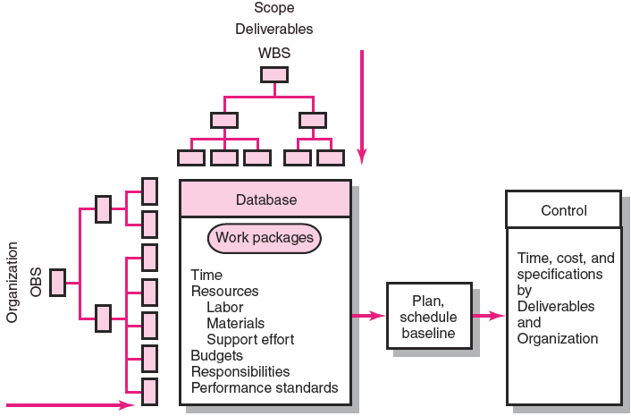
Project Management System Overview
FIGURE 13.3
Copyright © 2006 The McGraw-Hill Companies. All rights reserved.
McGraw-Hill/Irwin 13–<number>
Notes:
This figure presents an overview of the integrated information system

Slide 19
Development of Project Baselines
Purposes of a Baseline (PV)
  An anchor point for measuring performance
    A planned cost and expected schedule against which actual cost and schedule are measured.
    A basis for cash flows and awarding progress payments.
    A summation of time-phased budgets (cost accounts as summed work packages) along a project timeline.
What Costs Are Included in Baselines?
  Labor
  Equipment
  Materials
  Project direct overhead costs (DOC)
Copyright © 2006 The McGraw-Hill Companies. All rights reserved.
McGraw-Hill/Irwin 13–<number>

Slide 20
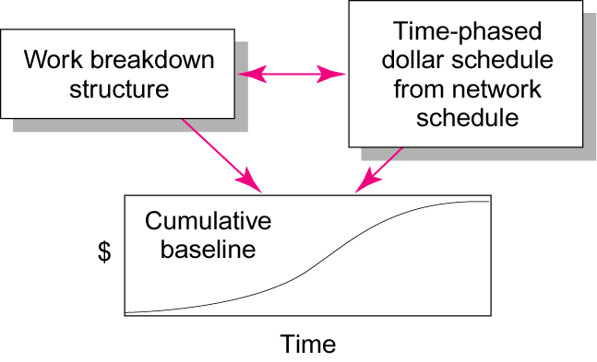
Baseline Data Relationships
FIGURE 13.4
Copyright © 2006 The McGraw-Hill Companies. All rights reserved.
McGraw-Hill/Irwin 13–<number>
Notes:
From WBS and network schedule, the project budget during periods from start to end of the project is identified.

Slide 21

Development of Project Baselines (cont’d)
Rules for Placing Costs in Baselines
  Costs are placed exactly as they are expected to be “earned” in order to track them to their point of origin.
  Percent Complete Rule
    Costs are periodically assigned to a baseline as units of work are completed over the duration of a work package.
Copyright © 2006 The McGraw-Hill Companies. All rights reserved.
McGraw-Hill/Irwin 13–<number>
Notes:
Eg: Activity A is 30% completed or Activity B is 100% completed. Question: How can we estimate the percentage completion of each activity?
Units of work: lines of codes, workdays, prototype complete…

Slide 22
Methods of Variance Analysis
Comparing Earned Value
  With the expected schedule value.
  With the actual costs.
Assessing Status of a Project
  Required data elements
    Data Budgeted cost of the work scheduled (PV)
    Budgeted cost of the work completed (EV)
    Actual cost of the work completed (AC)
  Calculate schedule and cost variances
    A positive variance indicates a desirable condition, while a negative variance suggests problems or changes that have taken place.
Copyright © 2006 The McGraw-Hill Companies. All rights reserved.
McGraw-Hill/Irwin 13–<number>

Slide 23
Methods of Variance Analysis
Cost Variance (CV)
  Indicates if the work accomplished using labor and materials costs more or less than was planned at any point in the project.
Schedule Variance (SV)
  Presents an overall assessment in dollar terms of the progress of all work packages in the project scheduled to date.
Copyright © 2006 The McGraw-Hill Companies. All rights reserved.
McGraw-Hill/Irwin 13–<number>
Notes:
Pls note that SV is in currency term, although it shows us progress assessment

Slide 24
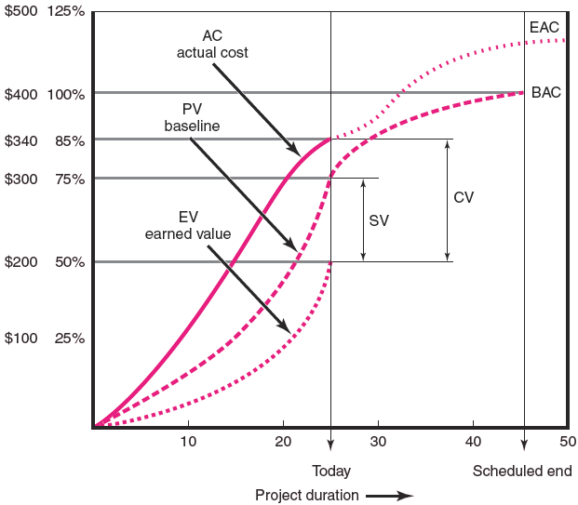
Cost/Schedule Graph
FIGURE 13.5
Copyright © 2006 The McGraw-Hill Companies. All rights reserved.
McGraw-Hill/Irwin 13–<number>

Slide 25
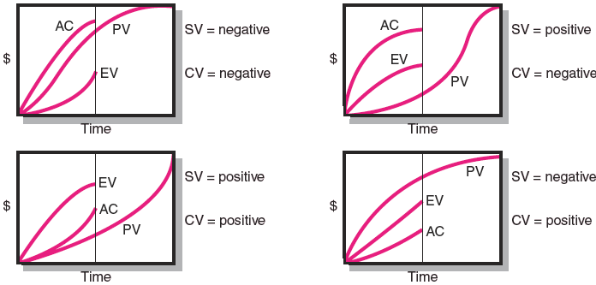
Earned Value Review Exercise
FIGURE 13.6
Copyright © 2006 The McGraw-Hill Companies. All rights reserved.
McGraw-Hill/Irwin 13–<number>

Slide 26
Developing A Status Report:
A Hypothetical Example
Assumptions
  Each cost account has only one work package, and each cost account will be represented as an activity on the network.
  The project network early start times will serve as the basis for assigning the baseline values.
  Baseline value will be assigned linearly, unless stated differently.
  From the moment work on an activity begins, some actual costs will be incurred each period until the activity is completed.
Copyright © 2006 The McGraw-Hill Companies. All rights reserved.
McGraw-Hill/Irwin 13–<number>

Slide 27
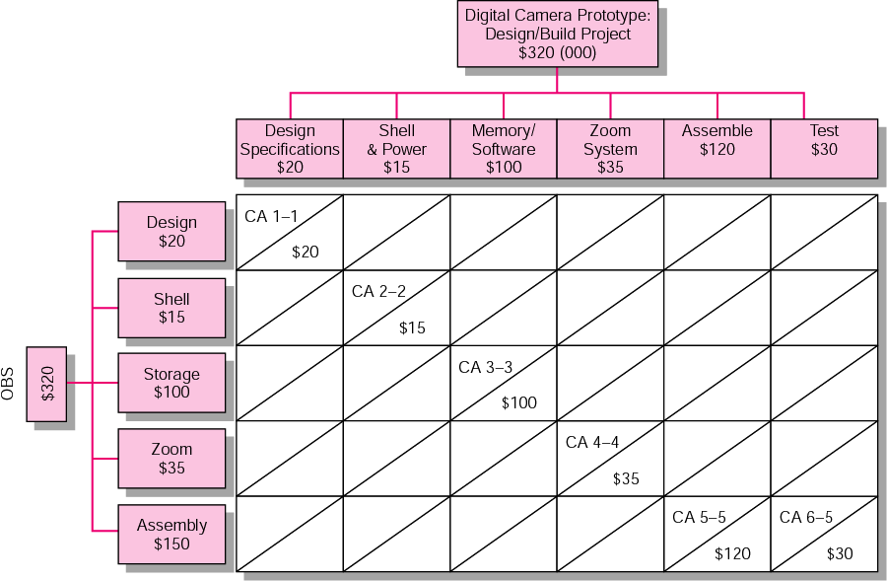
Work Breakdown Structure and Cost Accounts
FIGURE 13.7
Copyright © 2006 The McGraw-Hill Companies. All rights reserved.
McGraw-Hill/Irwin 13–<number>
Notes:
CA – Cost account
6 deliverables
5 responsible departments
Total for all cost accounts/ or the total project cost project is 320.000 USD

Slide 28
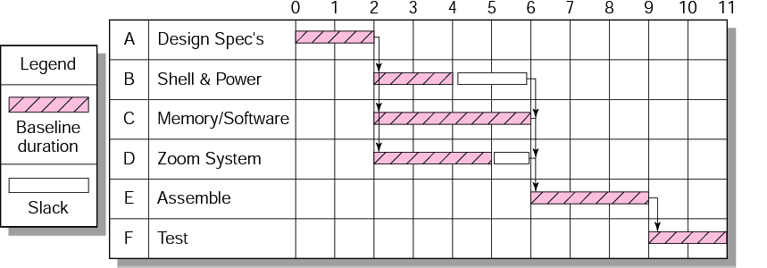
Digital Camera Prototype Project Baseline Gantt Chart
FIGURE 13.8
Copyright © 2006 The McGraw-Hill Companies. All rights reserved.
McGraw-Hill/Irwin 13–<number>
Notes:
This chart presents the planning Gantt chart of the project. The project is planned to prolong for 11 time units. This chart and WBS are used to time-phase the project budget baseline (in the next slide)

Slide 29
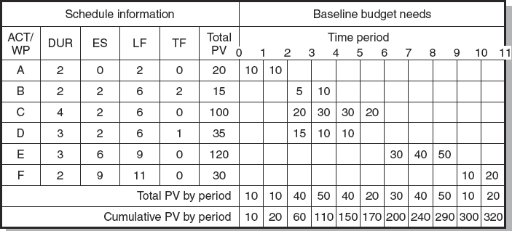
Digital Camera Prototype Project Baseline
FIGURE 13.9
Copyright © 2006 The McGraw-Hill Companies. All rights reserved.
McGraw-Hill/Irwin 13–<number>
Notes:
Early start budget baseline with cost assigned

Slide 30
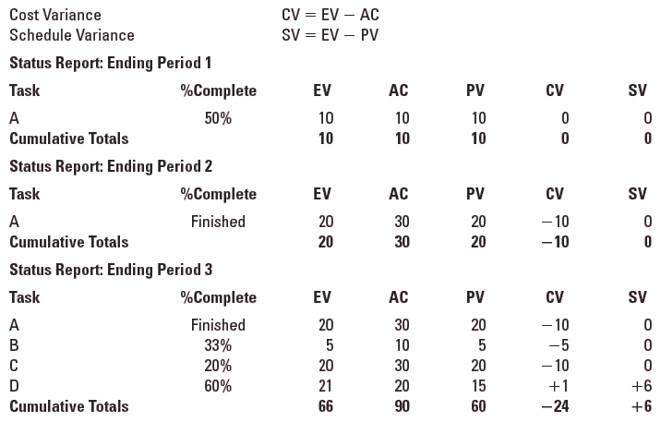
Digital Camera Prototype Status Reports: Periods 1–3
TABLE 13.2
Copyright © 2006 The McGraw-Hill Companies. All rights reserved.
McGraw-Hill/Irwin 13–<number>
Notes:
Measuring earned value begins at the work package levels. WPs are in one of 3 conditions on the report date (status date):
1 – Not yet start
2 – Finished
3 – In process/ partially complete

Slide 31
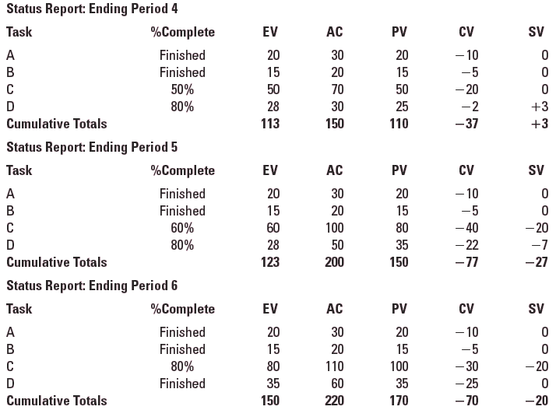
Digital Camera Prototype Status Reports: Periods 4–6
TABLE 13.2 (cont’d)
Copyright © 2006 The McGraw-Hill Companies. All rights reserved.
McGraw-Hill/Irwin 13–<number>

Slide 32
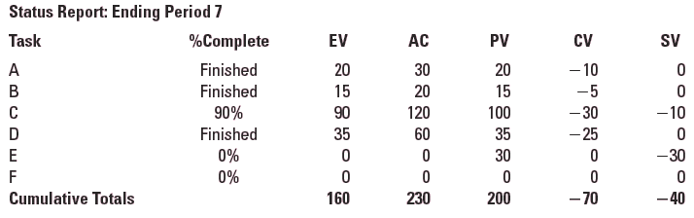
Digital Camera Prototype Status Reports: Period 7
TABLE 13.2 (cont’d)
Copyright © 2006 The McGraw-Hill Companies. All rights reserved.
McGraw-Hill/Irwin 13–<number>

Slide 33
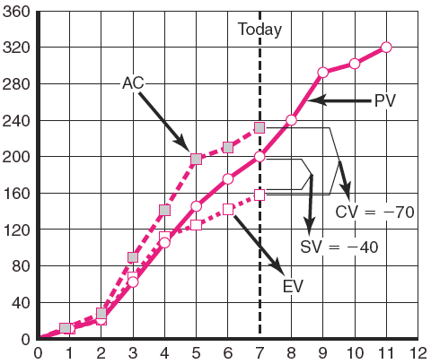
Digital Camera Prototype Summary Graph (000)
FIGURE 13.10
Copyright © 2006 The McGraw-Hill Companies. All rights reserved.
McGraw-Hill/Irwin 13–<number>

Slide 34
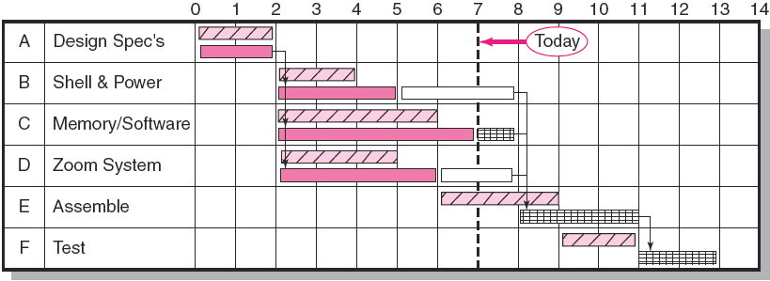
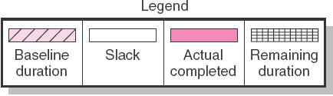
Digital Camera Project Tracking Gantt Chart
Showing Status—Through Period 7
FIGURE 13.11
Copyright © 2006 The McGraw-Hill Companies. All rights reserved.
McGraw-Hill/Irwin 13–<number>

Slide 35
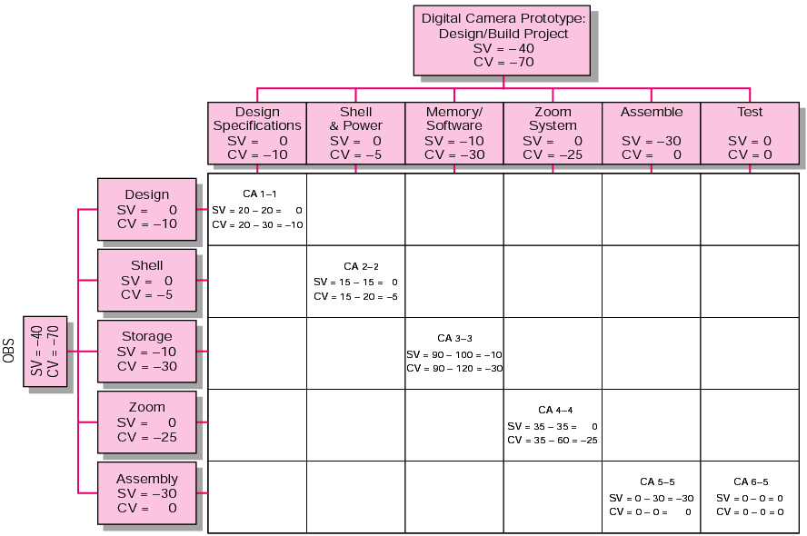
Digital Camera Project Rollup at End Period 7 (000)
FIGURE 13.12
Copyright © 2006 The McGraw-Hill Companies. All rights reserved.
McGraw-Hill/Irwin 13–<number>

Slide 36
Indexes to Monitor Progress
Performance Indexes
  Cost Performance Index (CPI)
    Measures the cost efficiency of work accomplished to date.
    CPI = EV/AC
  Scheduling Performance Index (SPI)
    Measures scheduling efficiency
    SPI = EV/PV
  Percent Complete Indexes
    Indicates how much of the work accomplished represents of the total budgeted (BAC) and actual (AC) dollars to date.
    PCIB = EV/BAC
    PCIC = AC/EAC
Copyright © 2006 The McGraw-Hill Companies. All rights reserved.
McGraw-Hill/Irwin 13–<number>
Notes:
PCI compare the to-date progress to the end of the project.
Implication underlying use of these indexes are that conditions will not change, no improvement or action will be taken, the information in the database is accurate.
PCIB look at percent complete in terms of budget amounts.
PCIC look at percent complete in terms of actual dollars spent to accomplish the work to date and the actual expected dollars for the completed project

Slide 37
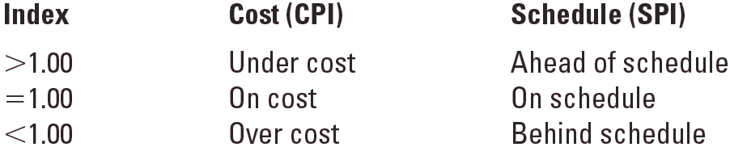
Interpretation of Indexes
TABLE 13.3
Copyright © 2006 The McGraw-Hill Companies. All rights reserved.
McGraw-Hill/Irwin 13–<number>

Slide 38
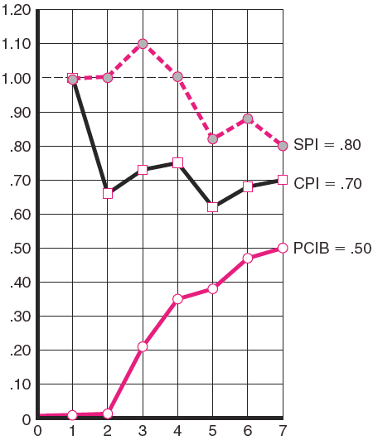
Indexes
Periods 1–7
FIGURE 13.13
Copyright © 2006 The McGraw-Hill Companies. All rights reserved.
McGraw-Hill/Irwin 13–<number>
Notes:
Summary graph of 3 indexes of Digital Camera project
PCIB look at percent complete in terms of budget amounts (EV/BAC)
PCIC look at percent complete in terms of actual dollars spent to accomplish the work to date and the actual expected dollars for the completed project (AC/EAC)
The PCIC index was not shown here, because the EAC would be derived each period by estimators in the field.

Slide 39
Project Cost/Schedule Systems Software
Typical Computer-Generated Status Report
  Schedule variance (EV-PV) by cost account and WBS and OBS
  Cost variance (EV-AC) by cost account and WBS and OBS
  Indexes—cost, schedule, total percent complete, and the to complete performance index
  Cumulative actual total to date (AC)
  Expected costs at completion
  Paid and unpaid commitments
Copyright © 2006 The McGraw-Hill Companies. All rights reserved.
McGraw-Hill/Irwin 13–<number>
Notes:
Software developers have created schedule/cost systems for projects that help track and report budget, actual, earned, index values; in terms of labors, equipments, materials, or costs.
Although you can find many different PM software nowadays, there are some typical information that we can find in a computer-generated status report…

Slide 40
Additional Earned Value Rules
Rules applied to short-duration activities and/or small-cost activities
  0/100 percent rule
    Assumes 100 % of budget credit is earned at once and only when the work is completed.
  50/50 rule
    Allows for 50% of the value of the work package budget to be earned when it is started and 50% to be earned when the package is completed.
  Percent complete with weighted monitoring gates
    Uses subjective estimated percent complete in combination with hard, tangible monitoring points
Copyright © 2006 The McGraw-Hill Companies. All rights reserved.
McGraw-Hill/Irwin 13–<number>
Notes:
Although the percent complete rule is the most-used method of assigning budgets, there are additional rules that are very useful for reducing the overhead costs of collections detailed data on percent complete of individual work packages.
0/100 percent rule → used for very short duration activities/ work packages
50/50 rule → popular for work packages with short duration and small total costs
➔ while using these two rules, we only collect the information related to the start and finish points of each work package
Percent complete with weighted monitoring gates → long-duration activities that can be broken into short, discrete work packages of no more than one or two report periods

Slide 41
Forecasting Final Project Cost
Methods used to revise estimates of future project costs:
  EAC_{e}
    Allows experts in the field to change original baseline durations and costs because new information tells them the original estimates are not accurate.
  EAC_{f}
    Uses actual costs-to-date plus an efficiency index to project final costs in large projects where the original budget is unreliable.
Copyright © 2006 The McGraw-Hill Companies. All rights reserved.
McGraw-Hill/Irwin 13–<number>

Slide 42

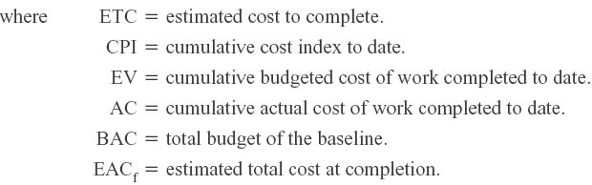
Forecasting Model: EAC_{f}
The equation for this forecasting model:
Copyright © 2006 The McGraw-Hill Companies. All rights reserved.
McGraw-Hill/Irwin 13–<number>

Slide 43
Other Control Issues
Issues In Maintaining Control Of Projects
Baseline Changes
Costs and Problems of Data Acquisition
Scope Creep
Copyright © 2006 The McGraw-Hill Companies. All rights reserved.
McGraw-Hill/Irwin 13–<number>
Notes:
Baseline changes → some good, some bad → careful, should allow only if it is clear that the project will fail without the change, the project will be improved significantly with the change, or the customer wants it and will pay for it → ALL CHANGES must be accepted and signed off by the project customer (who pay us money). The project managers usually make decisions on project changes. Sometimes, in a large project, there is a change review team responsible of making these decisions
Data acquisition is time consuming and costly. In some cases, data are not sent to the stakeholders who need information relating to project progress. And lacking information in a timely manner might lead to serious problems. To mitigate this problem, you must be careful while developing communication plan in the project planning phase
Scope creep → minor refinements→ some, many → major scope changes → problems

Slide 44
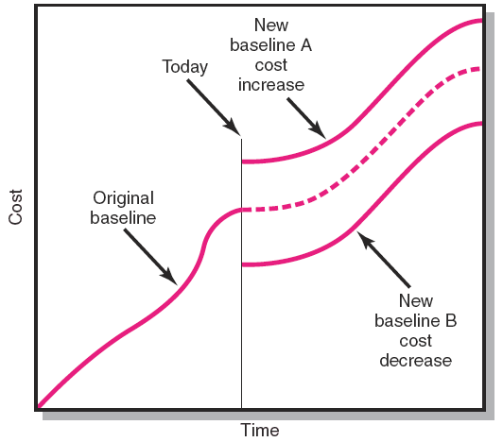
Scope Changes to a Baseline
FIGURE 13.14
Copyright © 2006 The McGraw-Hill Companies. All rights reserved.
McGraw-Hill/Irwin 13–<number>

Slide 45
Key Terms
Baseline budget
Cost performance index (CPI)
Cost variance (CV)
Earned value
Schedule variance (SV)
Time phasing
Variance at completion (VAC)
Estimate at completion (EAC)
Copyright © 2006 The McGraw-Hill Companies. All rights reserved.
McGraw-Hill/Irwin 13–<number>

Slide 46
QUIZ 5
The following labor hours data have been collected for a nanotechnology project. Compute SV, CV, SPI, CPI and PCIB for period 6. What is your assessment of the project at the end of period 6?

Slide 47
